Slide 1






AD-HOC INSIGHTS
ATLIQ HARDWARE
Presented by
Priyanka Mairal

Slide 2





AGENDA
Problem Statement
Approach
Dataset Overview
Ad-hoc requests

Slide 3




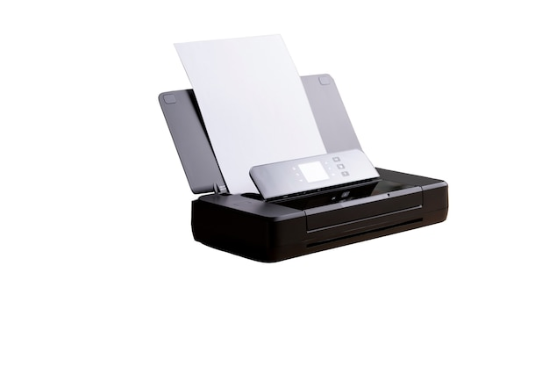




ATLIQ’S BUSINESS MODEL
CUSTOMER
CONSUMER

Slide 4


ATLIQ’S BUSINESS MODEL
PROBLEM STATEMENT
AtliQ is a hardware manufacturing company specializing in electronic devices and sales products like PC’s, mouse, printers through various channels to customers and consumers in India as well in other countries as well like China, Korea, APAC regions, Latin America etc.
However, management noticed that they are not getting enough insights to make quick and informed driven decisions.

Slide 5
ATLIQ’S BUSINESS MODEL
APPROACH:
AtliQ Hardware wants to do ad hoc analysis therefore analytical team decides to hire data analyst and assigned a task to generate to report to by running 10 ad-hoc requests using SQL.
They provide 10 ad-hoc requests and ask to solve using SQL queries, convert SQL outputs to visualization and present insights to stakeholders.

Slide 6
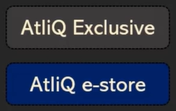


ATLIQ’S BUSINESS MODEL
RETAILER
DIRECT
DISTRIBUTOR

Slide 7
ATLIQ’S BUSINESS MODEL
AtliQ’s Sales Channels:
Retailer: Products are sold to brick-and-mortar or online stores and then to consumers.
Direct: Products are sold directly to consumers via AtliQ's own stores.
Distributor: In countries like China and South Korea, AtliQ sells to distributors due to government regulations or other business constraints. These distributors then supply products to stores.

Slide 8
ATLIQ’S BUSINESS MODEL
AtliQ’s Supply Chain Process:
Manufacturing units produce the hardware.
Products are shipped to warehouses and distribution centers.
From distribution centers, products are sent to stores across various locations.

Slide 9

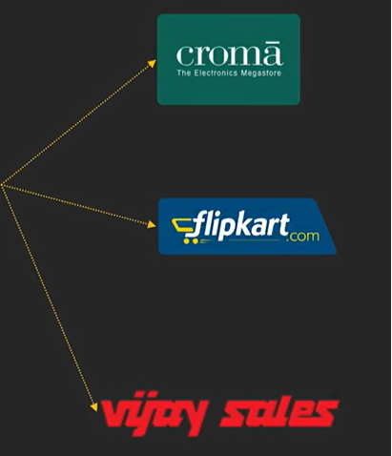

ATLIQ’S BUSINESS MODEL
WAREHOUSE
MANUFACTURING UNIT
STORES

Slide 10

01.
dim_customer: contains customer related data
02.
dim_product: contains product related data
ATLIQ’s
DATA MODEL
fact_gross_price: contains gross price information for each product
03.
Atliq consist of fact tables and dimension tables in dataset
fact_manufacturing_cost: contains the production cost of each product
04.
fact_preinvoice_deductions: contains preinvoice deductions information for each product
05.
fact_sales_monthly: contains monthly sales data for each product
www.reallygreatsite.com
06.

Slide 11




65%
70%
AD-HOC REQUESTS
55%
49%
www.reallygreatsite.com

Slide 12

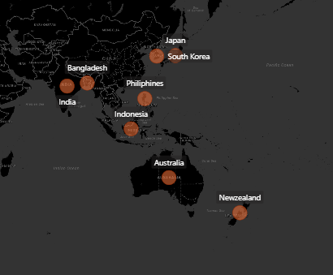
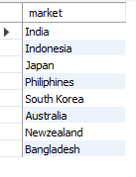
Business Request 1: Provide the list of markets in which customer “AtliQ Exclusive” operates its business in the APAC region.
INSIGHTS : AtliQ Hardware operates in 8 countries within the APAC region, focusing on key markets listed on the slide to drive regional business growth.

Slide 13
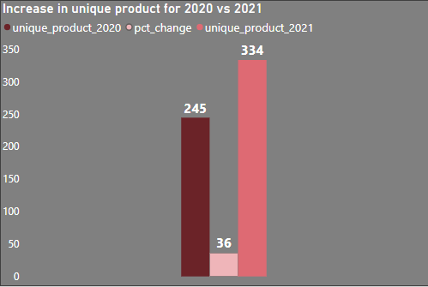
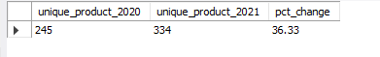
Business Request 2: What is the percentage of unique product increase in 2021 vs. 2020?
INSIGHTS : AtliQ Hardware achieved a 36.33% increase in unique products in 2021 compared to 2020, highlighting significant product growth year-over-year.

Slide 14
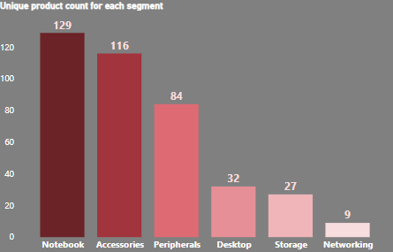
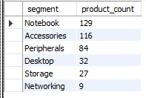
Business Request 3: Provide a report with all the unique product counts for each segment and sort them in descending order of product counts.
INSIGHTS : For AtliQ hardware, the Notebook segment has the highest product count, while Storage and Networking have the lowest.

Slide 15
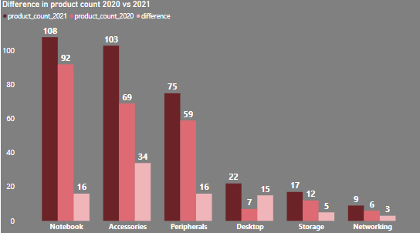
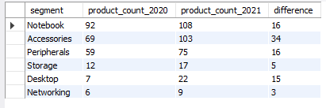
Business Request 4: Which segment has the most increase in unique products in 2021 vs 2020?
INSIGHTS : The segment with the most increase in unique products in 2021 compared to 2020 is Accessories, with a product count of 69 in 2020, 103 in 2021, and a difference of 34.

Slide 16
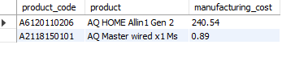

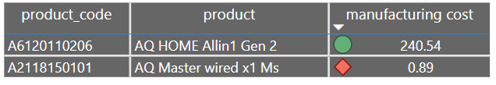

Business Request 5: Get the product have the highest and lowest manufacturing costs.
INSIGHTS : AQ HOME Allin 1 Gen 2 is a desktop having highest manufacturing cost and AQ Master wired x 1 Ms is mouse having lowest manufacturing cost among all the products manufactured by AtliQ Hardware.

Slide 17
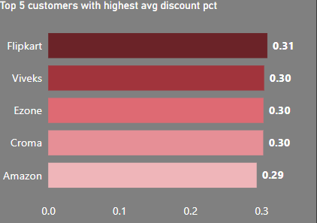
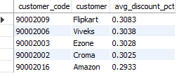
Business Request 6: Generate a report which contains the top 5 customers who received an average high pre_invoice_discount _pct for the fiscal year 2021 in the Indian market.
INSIGHTS : These are the top 5 customers in India, in which Flipkart offering the highest average discount contribute the most to sales, where as Amazon contributes the least.

Slide 18
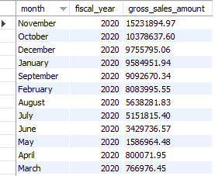
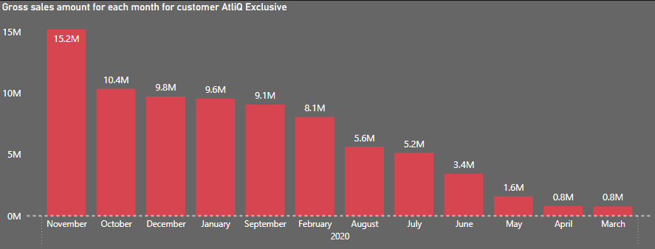
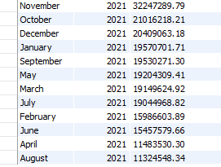
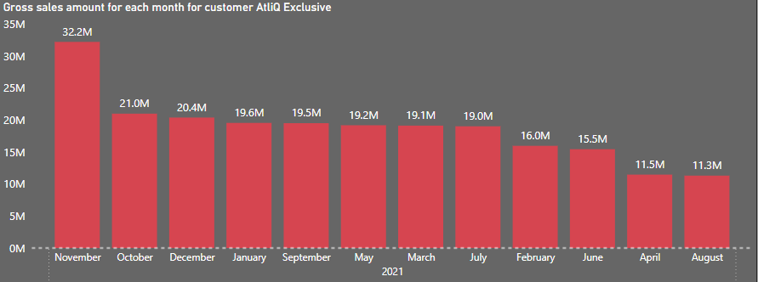
Business Request 7: Get the complete report of the Gross sales amount for the customer “AtliQ Exclusive” for each month.
INSIGHTS : For fiscal year 2021, November shows highest, and August shows lowest gross sales. And for fiscal year 2022, November shows highest and March shows lowest gross sales for AtliQ Exclusive.

Slide 19
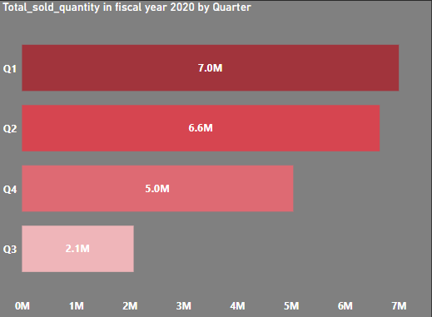
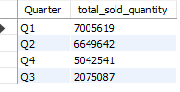
Business Request 8: In which quarter of 2020,got the maximum total sold quantity.
INSIGHTS : In 2020, Q1 experience the highest sold quantity. It suggests that beginning of the year has the strongest sales performance. And Q3 shows the lowest sold quantity.

Slide 20
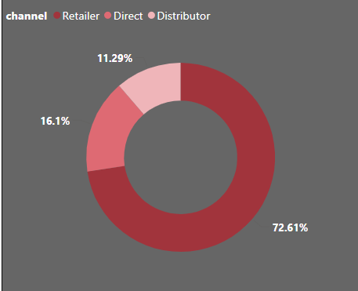
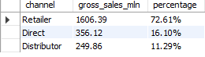
Business Request 9: Which channel helped to bring more gross sales in fiscal year 2021 and the percentage of contribution ?
INSIGHTS : The Retailer channel contributed 72% of gross sales in FY 2021, outperforming Direct (16%) and Distributor (11%).
Notes:
In FY 2021, Majority of sales happened through the Retailer channel (72%) while Direct and Distributor channels contributed only small percentage in the gross sales (16% and 11%) respectively.

Slide 21
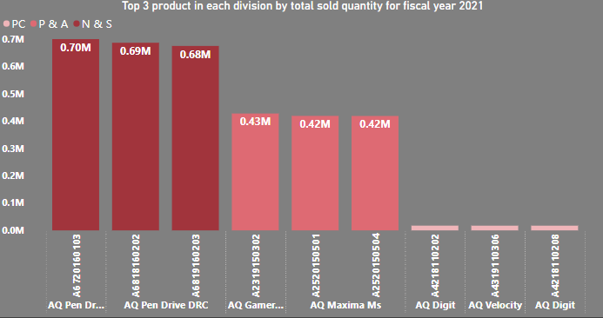
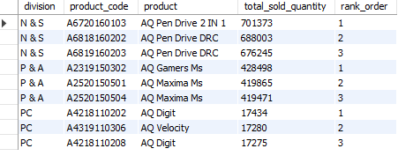



Business Request 10: Get top 3 products in each division that have a high total sold quantity in the fiscal year 2021 ?
INSIGHTS : Top 3 products in each division contributed significantly to total sold quantities in FY 2021 is Pen drive, Mouse and Desktop.

Slide 22

THANK YOU!

